Slide 1

AI-Powered Intrusion Detection & Threat Prediction
Cyberattacks exploit unseen vulnerabilities, outpacing traditional security. This presentation outlines an AI-driven Intrusion Detection System (IDS). It will dynamically learn and predict emerging threats. Join us as we explore innovative methods for a safer digital future.

Slide 2

AI-Driven Intrusion Detection System (IDS)
1
Data Preprocessing & Feature Engineering
2
ML & DL Models
LSTM/GRU for sequential anomalies, GNNs model attack propagation. Isolation Forests and Autoencoders detect anomalies.
Timestamps converted, missing values handled. Key features extracted: packet entropy and request frequency.
3
Performance Metrics
FPR & FNR balanced. Accuracy and explainability achieved via SHAP values for trust.

Slide 3




Technologies & Tools Used
Python
TensorFlow & PyTorch
Google Colab & Cloud
Primary programming language for development.
Deep learning frameworks for model training.
Environments for training and real-time deployment.
Flask API for real-time intrusion detection
The tech stack utilizes Python. It incorporates TensorFlow and PyTorch for deep learning. Also used are Google Colab and cloud deployment for real-time threat detection.

Slide 4
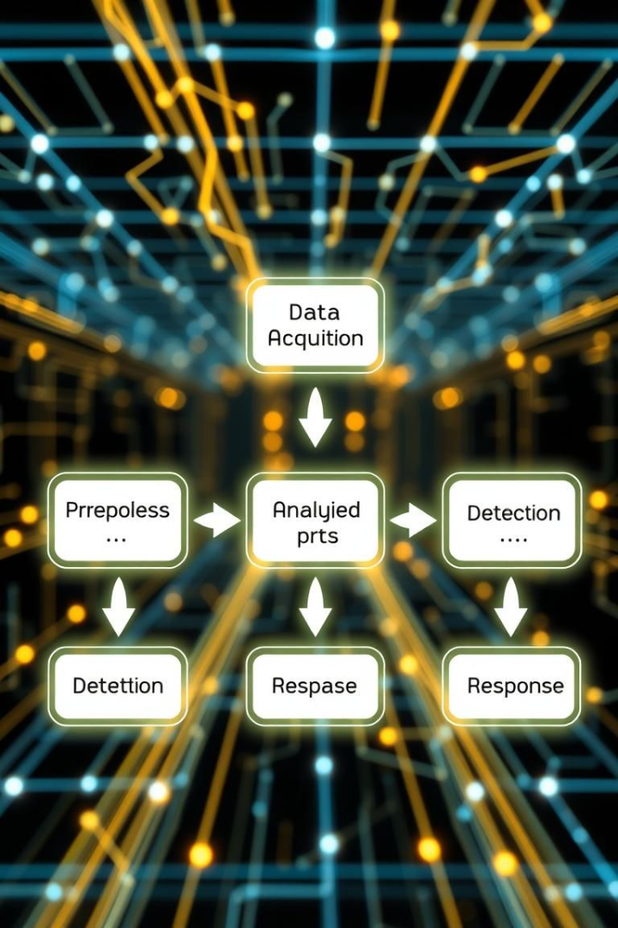




Intrusion Detection System Workflow
Data Collection & Preprocessing
CICIDS2017 loaded, cleaned, features extracted.
Model Training & Evaluation
LSTM, GNN, Isolation Forest, XGBoost trained. Confusion matrices provide performance insights.
Explainability & Optimization
SHAP values interpret decisions and are optimized for edge computing.
Real-time Detection
Model deployed on live traffic using Flask API.to adapt using online learning.

Slide 5
Why CIC-IDS-2017?
Dataset Comparison
Dataset
Attacks Included
Pros
Cons
NSL-KDD
DoS, Probe, R2L, U2R
Well-structured, widely used
Outdated attack types
CIC-IDS-2017
DDoS, Botnet, Brute Force, Phishing
Real-world network traffic
Large dataset, requires cleaning
UNSW-NB15
Fuzzers, Backdoor, DoS, Exploits, Worms
Modern attack types
More complex feature extraction
TON_IoT
IoT and Cloud attacks
Focuses on IoT security
Newer, less commonly used
Key Benefits
Diverse attacks relevant to current threats.
Real-world network traffic applicability.
Models adapt to dynamic environments.

Slide 6
Real-time Intrusion Detection API
1
Flask API for Inference
2
Real-time Data
3
Deployment
Uses a Flask API to classify network traffic in real-time.
Handles real-time network data, using trained models to classify traffic.
Host the API on cloud platform for network monitoring.

